Slide 1
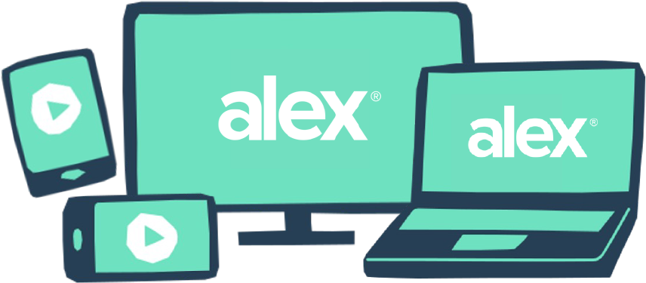
Open enrollment is coming
Cross your I’s and dot your T’s
In the same way we probably should have double checked our headline, you should double check your benefits.
You don't need to do anything to stay on your current plans. But if your situation has changed or you just want to see if there are more affordable plans out there, take 10 minutes and review your options with ALEX, our virtual benefits counselor.
Before you enroll, give it a try at <www.sampleURL.com>.
QR CODE HERE
YOUR LOGO HERE

