Slide 1
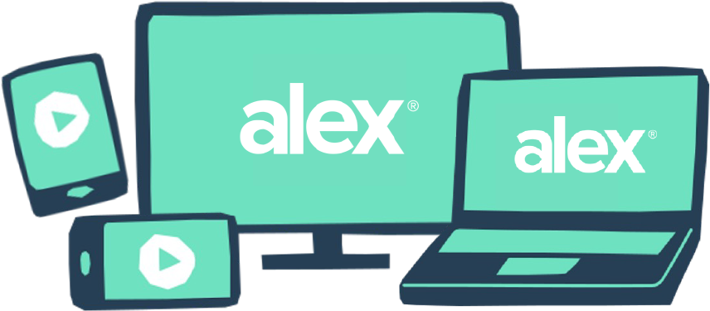
Let ALEX ID help you be happier and healthier with half the effort.
Don’t be one of those people frantically scheduling doctor appointments in December. When you sign up for a free ALEX ID, you’ll get personalized reminders and recommendations all year long to help you get the most out of your employer’s benefits.
WITH AN ALEX ID, YOU GET:
Unbiased, just-for-you advice. ALEX sends you texts and emails with personalized content tailored to your preferences.
Timely reminders to schedule preventive care. Preventive care is usually free (but super easy to forget). ALEX can send you the nudge you need.
A digital friend with a memory like a trap. Sign in with your ALEX ID before you talk to ALEX and he’ll remember all your choices to speed things up next time.
Education that goes beyond your basic benefits. Dig deeper on mental health support, financial wellness, telemedicine, and more.
Total confidentiality. Your employer pays for ALEX, but has no access to any of your responses or data.
QR CODE HERE
Set up your ALEX ID now at <sampleURL.com>
YOUR LOGO HERE

